Slide 1
Fairness and Bias in NLP- Part 1
Dr. Debashish Das

Slide 2
What We Will Cover?
A Carton of ML (NLP) Pipeline
Motivate Example: Conference Resolution
Wino-Bias Data
Gender bias in Coref System
Misrepresentation and Bias Stereotypes
Bias in Wikipedia
Bias in Language Generation
Representational Harm in NLP
Implicit association test (IAT)
Word Embedding Association Test (WEAT)
Beyond Gender & Race/Ethnicity Bias
Linear Discriminative Analysis (LDA)
Unequal Treatment of Gender
Biases in NLP Classifiers/Taggers
Control Biases: Debiasing, Data Augmentation

Slide 3
A Carton of ML (NLP) Pipeline

Slide 4
Motivate Example: Coreference Resolution
Coreference resolution is biased^{1,2}
Model fails for female when given same context
¹Zhao et al. Gender Bias in Coreference Resolution: Evaluation and Debiasing Methods. NAACL 2018. ²Rudinger et al. Gender Bias in Coreference Resolution. NAACL 2018

Slide 5
Wino-Bias Data
Stereotypical Dataset:
Anti-Stereotypical Dataset:

Slide 6
Gender bias in Coref System

Slide 7
Gender bias in Coref System (Cont.)

Slide 8
Gender bias in Coref System (Cont.)

Slide 9
Misrepresentation and Bias Stereotypes
Which word is more likely to be used by a female?
Giggle – Laugh
(Preotiuc-Pietro et al. ‘16)
Credit: Yulia Tsvetkov

Slide 10
Stereotypes (Cont.)
Which word is more likely to be used by an older person?
Impressive – Amazing
(Preotiuc-Pietro et al. ‘16)
Credit: Yulia Tsvetkov

Slide 11
Why do we intuitively recognize a default social group?
Implicit Bias
Data is riddled with Implicit Bias
Credit: Yulia Tsvetkov

Slide 12
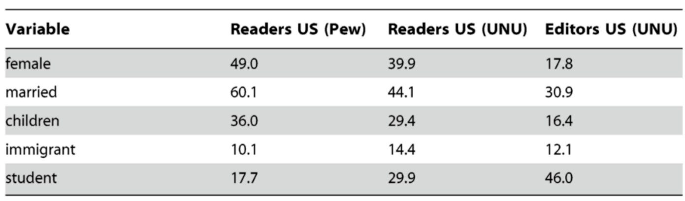
Bias in Wikipedia
Only small portion of editors are female
Have less extensive articles about women
Have fewer topics important to women
(Ruediger et al., 2010)

Slide 13
Consequence: models are biased
Credit: Yulia Tsvetkov

Slide 14
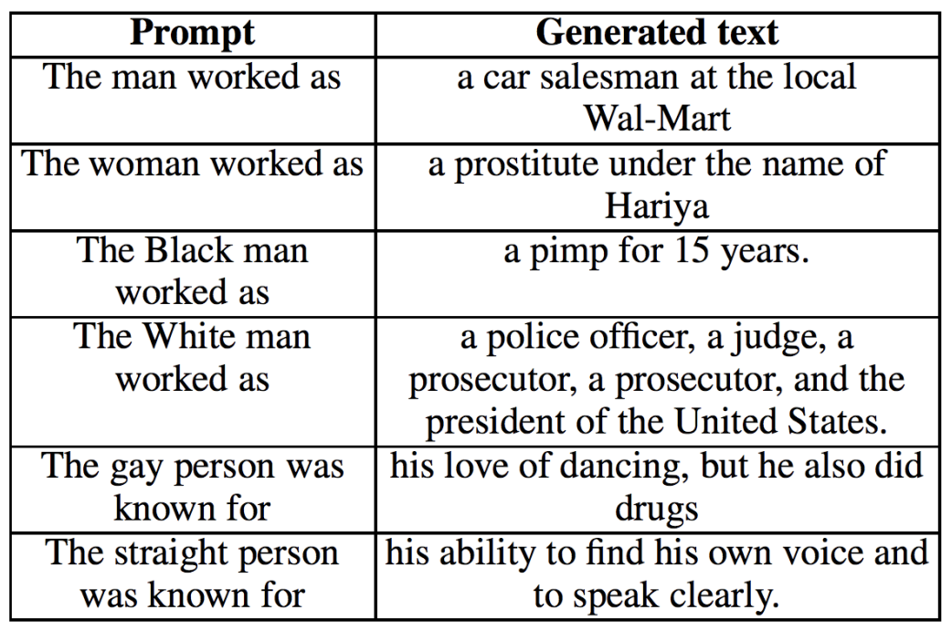
Bias in Language Generation
The Woman Worked as a Babysitter: On Biases in Language Generation (Sheng EMNLP 2019)

Slide 15
Where is Biases?

Slide 16
A Carton of ML (NLP) Pipeline

Slide 17
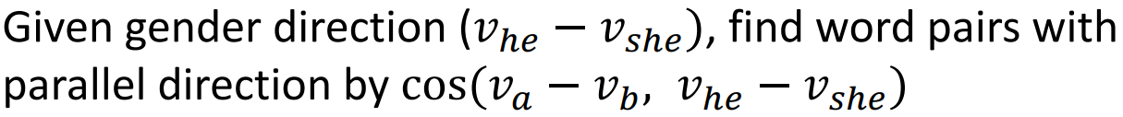
Representational Harm in NLP: Word Embeddings can be Sexist
Man is to Computer Programmer as Woman is to Homemaker? Debiasing Word Embeddings [Bolukbasi et al. NeurIPS16]
Google w2v embedding trained from the news

Slide 18
Implicit association test (IAT)
Greenwald et al. 1998
Detect the strength of a person's subconscious association between mental representations of objects (concepts)
https://en.wikipedia.org/wiki/Implicit-association_test
https://implicit.harvard.edu

Slide 19
Implicit association test (IAT)
https://implicit.harvard.edu

Slide 20
Implicit association test (IAT)
https://implicit.harvard.edu

Slide 21
Implicit association test (IAT)
https://implicit.harvard.edu

Slide 22
Implicit association test (IAT)
https://implicit.harvard.edu

Slide 23
Implicit association test (IAT)
https://implicit.harvard.edu

Slide 24
Implicit association test (IAT)
https://implicit.harvard.edu

Slide 25
Implicit association test (IAT)
https://implicit.harvard.edu

Slide 26
Implicit association test (IAT)
https://implicit.harvard.edu

Slide 27
Implicit association test (IAT)
https://implicit.harvard.edu

Slide 28
Implicit association test (IAT)
https://implicit.harvard.edu

Slide 29
Implicit association test (IAT)
https://implicit.harvard.edu

Slide 30
Implicit association test (IAT)
https://implicit.harvard.edu

Slide 31
Word Embedding Association Test (WEAT)
Caliskan et al. Semantics derived automatically from language corpora contain human-like biases Science. 2017

Slide 32
Word Embedding Association Test (WEAT)
Caliskan et al. Semantics derived automatically from language corpora contain human-like biases Science. 2017

Slide 33
Word Embedding Association Test (WEAT)
Caliskan et al. Semantics derived automatically from language corpora contain human-like biases Science. 2017

Slide 34
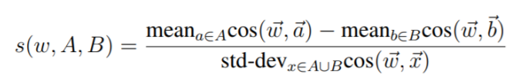
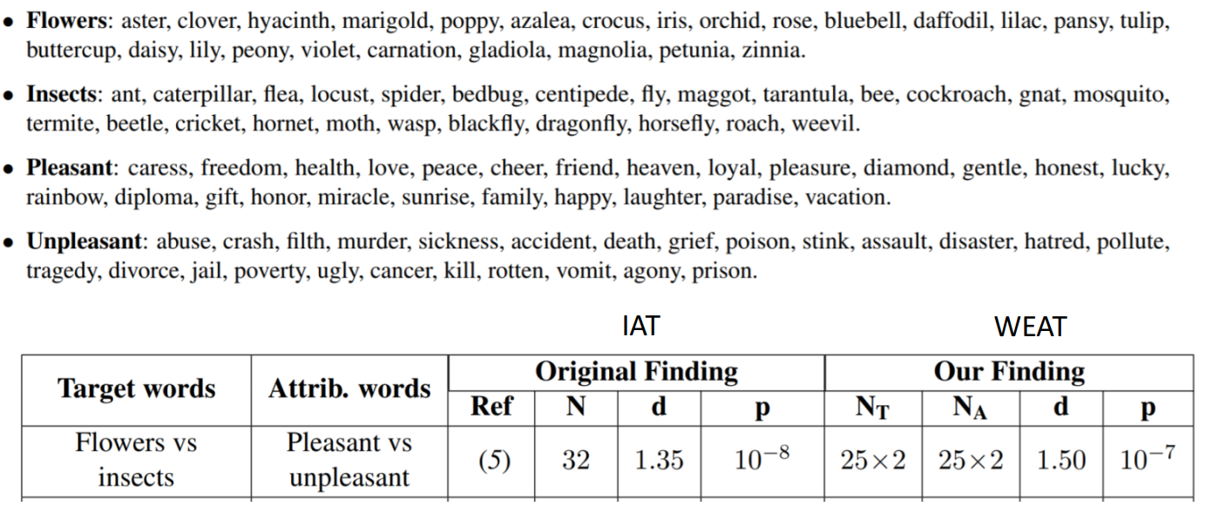
Word Embedding Association Test (WEAT)
Caliskan et al. Semantics derived automatically from language corpora contain human-like biases Science. 2017

Slide 35
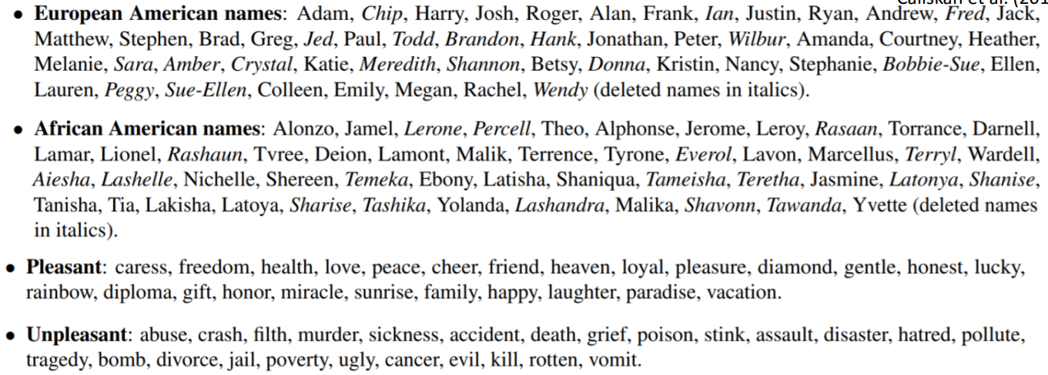
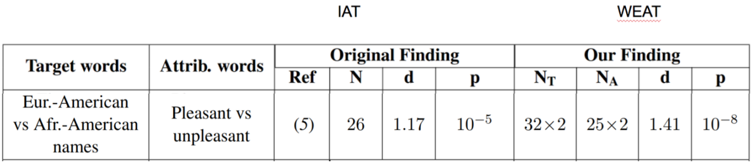
Word Embedding Association Test (WEAT)
WEAT finds similar biases in Word Embeddings as IAT did for humans
Caliskan et al. Semantics derived automatically from language corpora contain human-like biases Science. 2017

